Slide 1
Functions & Objects
IDIA 618
Spring 2012
Bridget M. Blodgett

Slide 2
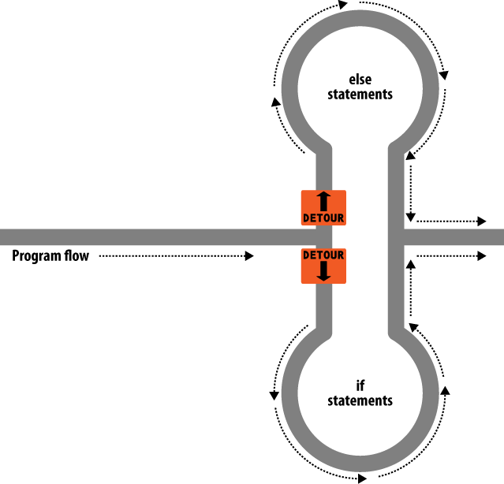
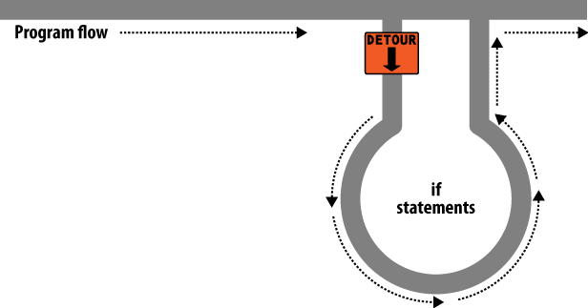
If and If…Else

Slide 3
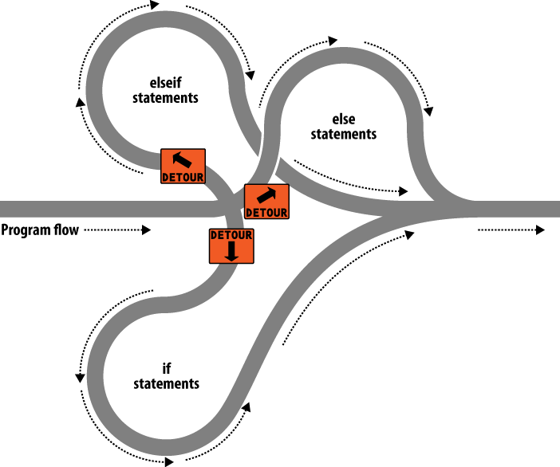
Elseif

Slide 4
Switch Statements
Very useful when an input can have multiple but pre-known values (like from a drop-down menu)
<?php
switch ($page) { //or : instead of {
case "Home": echo "You selected Home";
break;
case "About": echo "You selected About";
break;
case "News": echo "You selected News";
break;
case "Login": echo "You selected Login";
break;
case "Links": echo "You selected Links";
break; } //or endswitch if used with :
?>

Slide 5
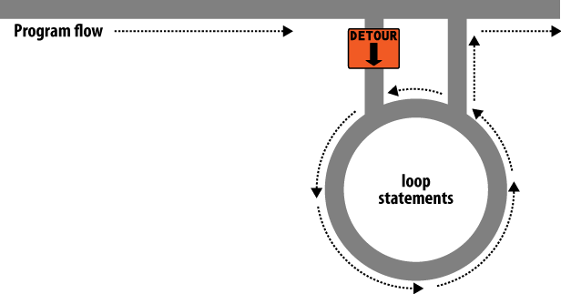
Looping
While
Do while
For
Break & Continue
Like in switch statements break will exit the loop structure altogether
Continue ends the current loop and starts the next one

Slide 6
Looping Exercises
For this exercise you will be creating a loop that prints out a series of asterisk in a specific pattern
Pattern 1:
*
*
*
*
*
Pattern 2:
*****
*****
*****
*****
*****
Pattern 3:
*
**
***
****
*****
Pattern 4:
*
**
***
**
*

Slide 7
Functions in PHP
Functions allow you to create discrete sections of code that perform one action
This prevents the unnecessary duplication of code and saves time, money, and reduces errors and code complexity
An object contains one or more related functions as well as all the data containers (variables) and manipulators (expressions) related to them within a class

Slide 8
Built-in Functions
We’ve already seen some of PHP’s built-in functions
Print();
Time();
The parentheses after the name tell the parser that this is a function and not some other construct.

Slide 9
Functions
Functions can be (but are not required to be) passed some starting information, an argument
When creating your own functions you must start the line with the declaration
function function_name()
Unlike variables function names are not case sensitive
The curly brackets after the parentheses contain the code that will execute when the function is called

Slide 10
Function Outputs
In addition to taking inputs called arguments functions can optionally return some type of output
The output of functions can be nested inside other functions
Remember: PHP works from the inside out so the function on the inside will be completed before others on the outside
Example 5 -2

Slide 11
Exercise
Add a function to the PHP script below which takes two parameters: (1) the number of years and (2) the amount of money to be put on a savings account. The function should calculate the amount that will have been reached after the given number of years. To print an amount with no more than two decimals, us the sprintf function, for instance, as follows: sprintf("%.2f", $amount ) ;

Slide 12
<?php
/* Add function here */
print "<p><b>The current interest rate is 5%.</b></p>" ;
print " <p>When you deposit &#x20AC; 50 today, your savings accounts will have grown to &#x20AC;" ;
print calculateAmount(10 , 50) ;
print " in 10 years.</p>" ; print " <p>When you deposit &#x20AC; 1,500 today, your savings will have grown to &#x20AC;" ;
print calculateAmount(20 , 1500) ;
print " after 20 years.</p>" ;
?>

Slide 13
Returning Multiple Pieces of Data
Returning the results of an array is one way to return multiple pieces of data from within the same function
Example 5-3 uses an array to return each fixed name

Slide 14
Passing By Reference
The & symbol, when put in front of a variable, tells the parser to pass a reference to the variable’s value, not the value itself
Dealing with values passed as an argument to a function is like Xeroxing the value of the variable, any changes you make to the copy won’t alter the original
Passing by reference means handing off the original document for alteration

Slide 15
Global Variables
It is possible to declare a variable that exists outside of a function ($a in the examples we’re using) a global variable from inside a function
Example 5-5
This means that nothing has to be passed directly to or from the function, it can access the variables directly
BUT! This makes the variables global permanently, a potential security issue

Slide 16
PHP and Object Oriented Programming (OOP)
Objects take a series of related functions and group them together into one thing
Unlike libraries objects ALSO include all of the data/variables relevant to those functions as well
Classes are the blueprints for the creation of an object, they contain all the needed information but the details are unique to each object
The object is referred to as an instance of that class

Slide 17
OOP
When dealing with a program that is object oriented a new set of terms overrides the ones we’ve discussed so far:
Variables(data) become Properties
Functions become Methods
While referring to their non-OOP names is not taboo, learning the correct terms is important for 1) understanding what others say, 2) distinguishing yourself as a savvy programmer/user

Slide 18
Encapsulation
Much like you want to limit how much access is available to your variables, you will want to limit what can be accessed/manipulated about a class
Encapsulation is writing a class in such a way that only its methods(functions) can be used to manipulate its properties(variables/data).
How can this be a good design principle?
The methods you supply are known as the object’s interface.

Slide 19
Inheritance
Occasionally we will want to make a class that has the same functionality as one we already have but that includes some refining or expansion upon the original
Instead of just updating the existing class, which can result in useless, bloated classes (and code) create a new class that inherits the structure of the original
All of the properties and methods of the parent class will be available but you can add in unique features or methods that only apply to this sub-class

Slide 20
PHP and OOP
PHP allows you to create and define classes for use within your program
Example 5-10 shows the syntax for doing this
When dealing with a dynamic and user-driven website, how could the concept of classes be useful for handling all the different types of data?
((For right now… this is all you need to understand about PHP and OOP))

Slide 21
Include & Require
Often some function will be needed in a program but you don’t have the time/skill/energy to create it yourself
Libraries are a method of creating suites of common, useful functions
At the start of the PHP program simply write include “yourlibrary.php”; to add these functions to your program
include_once will include the library if it hasn’t done so yet and ignore the include if it has. Why is this useful?
require or require_once means that if the parser fails at including the library the code will fail altogether. Why is this useful?

