Slide 1
Strings
IDIA 618
Spring 2013
Bridget M. Blodgett

Slide 2
Strings on the Web
The bulk of web data is manipulated or used in some type of string form
In order to handle this PHP has significant functionality built in to deal with strings
Nearly 100 that focus exclusively on strings
Some popular functions include:
Searching for text, replacing pieces of text, (re)formatting text, encoding/decoding, and regular expressions

Slide 3
Quotes
Always check to make sure you are using the appropriate types of quotation marks (‘’ or “”)
‘’ will reproduce the string exactly as it is typed
“” will try to interpret the string and use additional features where appropriate:
Any variable names in the string will be replaced with that variables value
Special characters can be included through the use of an escape

Slide 4
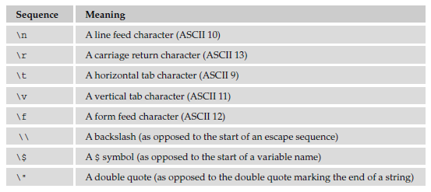

Slide 5
Implementing Variables
If you are trying to substitute the contents of a variable in a string it can be a bit complicated
For example:
$favoriteAnimal = “cat”;
echo “My favorite animals are $favoriteAnimals”;
There are a couple different ways to solve this problem 1) using {} to offset the variable or 2) interweave “” and php using the concatenator

Slide 6
HEREDOC & NOWDOC
$myString = < < < DELIMITER
(insert string here)
DELIMITER;
$myString = < < < ’DELIMITER’
(insert string here)
DELIMITER;

Slide 7
String Functions
To find a string’s length: strlen($var)
Useful to: loop through all the characters in a string or validate a string to make sure it ’ s the correct length
Strings are indexed similar to arrays
So you can use $var[0] to add or determine the placement of a character in a string
Substr($var, start, end)
Negative numbers count backwards from the end
Substr_replace($var) lets you actually replace characters

Slide 8
Searching Strings
strstr($var, “str”, true) – is the text in the string? The true shows the text to the start of found text
strpos($var, “str”) / strrpos($var, “str”) – index position of first and last occurrence of the text
substr_count($var, “str”) – how many times does it occur?
strbrk ($var, “str”, startat) – find any of a list of characters and displays the rest of the string from the first found

Slide 9
Replacing Text
str_replace(“str1”, “str2”, $var, $num)
substr_replace($var, “str”, position, num to replace) – replaces the remainder of the text with the string and provides a new copy of the string (or up to the num you specify)
Negative numbers replace from the end of the string and a 0 simply inserts the new text
strtr($var, what to replace, replacement)
Great for cleaning inputs (replacing “ “ with %20)

Slide 10
Changing Case
strtolower()
ucfirst()
lcfirst()
ucwords()
To make searching case insensistive:
stristr(), stripos(), strripos(), str_ireplace()

Slide 11
Trimming Strings
trim() removes white space from the beginning and end of a string
ltrim() removes white space only from the beginning of a string
rtrim() removes white space only from the end of a string
You can also specify characters to treat as whitespace

Slide 12
$milton1 = “1: The mind is its own place, and in it self\n”;
$milton2 = “2: Can make a Heav’n of Hell, a Hell of Heav’n.\n”;
$milton3 = “3: What matter where, if I be still the same,\n”;
echo “ < pre > ”;
echo ltrim( $milton1, “0..9: “ );
echo ltrim( $milton2, “0..9: “ );
echo ltrim( $milton3, “0..9: “ );
echo “ < /pre > ”;

Slide 13
Shaping Strings
str_pad($var, padding, character, STR_PAD_LEFT/RIGHT/BOTH) – adding padding to the string
wordwrap($var , linelength, char to use)
By default uses the \n but can be set to use things like <br/>
Number_format($var, # decimal places, replace decimal, replace commas)

Slide 14
Exercise
Using these string functions create a box similar to the one we made last week using a loop
Change the text in your strings so the outline of the box is different than the inside of the box

