Slide 1
What is PHP?
IDIA 618.185
Fall 2014
Bridget M Blodgett

Slide 2
Class Overview
Introduction
What is PHP?
How to use PHP?

Slide 3
DNSes
The “Internet”
External IP
Router with NAT
ISP
Home Network
141.145.2.7
Modem
Webpage
Other
Email
Video Game
Router (Wireless/Wired)
Web server
User 1
192.168.1.2
User 3
192.168.1.4
User 4
192.168.1.5
User 2
192.168.1.3
Other “Personal” Network
Internal IP
Router with NAT

Slide 4
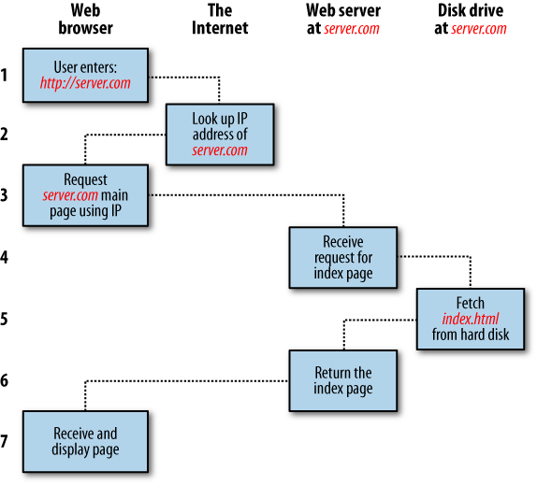

Slide 5
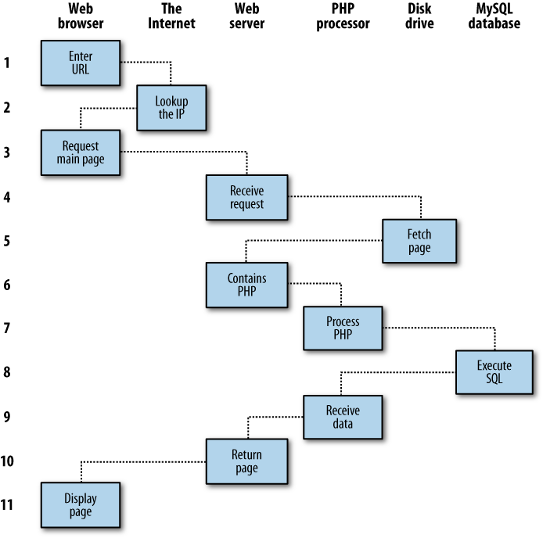

Slide 6
How are “dynamic” pages different from static or basic web pages?

Slide 7
What is PHP?
Originally stood for Personal Home Page but since changed to PHP: Hypertext Preprocessor
One of the “winners” of the Web 1.0+ wars
Integration with MySQL
Adopted easy and recognizable syntaxes
Extends and works well with HTML and XML
One of the first languages to be embedded IN the browser page
Why would this be useful?

Slide 8
What is PHP?
PHP files work as long as the web server has PHP running and the file ends in .php
Output most of the results of the processing as HTML files
However, you can also parse .html and .htm files through the PHP server as well
Why would web administrators want to do this?

Slide 9
Server vs. Client Side
PHP is a server side processing language
This means that only finished results are sent to the user’s computer
All the important data is stored on the server and never leaves it
This is different from a language like JavaScript which is a client side language
In which your code and all the processing is done by the user’s computer

Slide 10
What Are Syntaxes?
Syntax is the grammar of computer languages
PHP draws upon two main types
C Syntax
Use of curly brackets, semicolons, role of whitespace
perl Syntax
$ to being variable names, associative arrays

Slide 11
Philosophy of PHP*
You are a responsible and intelligent programmer
You know what you want to do
Some flexibility in syntax is OK – style choices are OK
Lets make this as convenient as possible
Sometimes errors fail silently

Slide 12
What Is Needed For PHP?
Ideally just ending a file in .php makes it a PHP file, even if all the content is HTML
Beyond that the <?php and ?> tags are needed to indicate sections that contain PHP code (so the parser knows when to start reading)
All the HTML in a page can be output from within these PHP tags or the tags can be embedded within the HTML

Slide 13
Embedding PHP
For this class most of our PHP will be embedded in a basic HTML page
Although pages of “pure” PHP will also work
Embedding your PHP code is useful because it allows for some styling to be applied to the output

Slide 14
<HTML>
<BODY>
<p>I am going to say hello. <?php echo “Hello”; ?></p>
</BODY>
</HTML>
<?php
echo “<HTML>”;
echo “<BODY>”;
echo “<p>I am going to say hello.”
echo “Hello!”;
echo “</p>”;
echo “</BODY>”;
echo “</HTML>”;
?>

Slide 15
Commenting
Comments are extremely important
They allow others to understand what each part of your code does
They allow you to remember what you were trying to do
They can often act as the basis for a guide or user manual for other who may need to edit/update your code

Slide 16
Comment Types
Two types of comments
Single Line \\
Good for removing a single line of code
Adds literal comments to the end of a line of code
Multi-line /* */
Good for removing blocks of code (that may not be working)
Can’t be nested (one put around another)

Slide 17
Semicolons
Every PHP statement must end with a semicolon
If the PHP parser doesn’t see one it will assume each line is connected
Results in weird output and errors
Single most common error when programming in PHP

Slide 18
PHP Variables
Must have a $ before their name
Can contain a-z, A-Z, 0-9, or start with _
Capitalization matters!
$Class, $class, $CLASS, $ClAsS are all different variables
Spelling Matters
From the book Referer and Referrer are two different names
Reserved words cannot be used

Slide 19
PHP Keywords
abstract (as of PHP 5) | and | array() | as | break
case | catch (as of PHP 5) | cfunction (PHP 4 only) | class | clone (as of PHP 5)
const | continue | declare | default | do
else | elseif | enddeclare | endfor | endforeach
endif | endswitch | endwhile | extends | final (as of PHP 5)
for | foreach | function | global | goto (as of PHP 5.3)
if | implements (as of PHP 5) | interface (as of PHP 5) | instanceof (as of PHP 5)
namespace (as of PHP 5.3) | new | old_function (PHP 4 only) | or | private (as of PHP 5)
protected (as of PHP 5) | public (as of PHP 5) | static | switch | throw (as of PHP 5)
try (as of PHP 5) | use | var | while | xor

Slide 20
Other Reserved Words
Language constructs
die() | echo() | empty() | exit() | eval()
include() | include_once() | isset() | list() | require()
require_once() | return() | print() | unset() | __halt_compiler()
Compile-time constants
__CLASS__ | __DIR__ (as of PHP 5.3) | __FILE__ | __LINE__ | __FUNCTION__ | __METHOD__
__NAMESPACE__ (as of PHP 5.3)

Slide 21
Strings
Strings are one type of variable
They contain letters or whole phrases
Can be assigned directly to a variable
Or can be read from user input (we’ll address this later)

Slide 22
Numbers
PHP doesn’t have classifications of the types of numbers that it accepts
$num = 4
$num = 3.14
Both are equally valid as variables

Slide 23
Arrays
Method of storing larger amounts of information that is related in some way
e.g. The names of your intramural team
$team = array('Bill', 'Joe', 'Mike', 'Chris', 'Jim');
Arrays begin counting at 0 and go up

Slide 24
N-Dimensional Arrays
An array of arrays
Holds multiple pieces of information
Sometimes of different types
Keeps the relationships between those pieces whole
Warehouses at Amazon.com

Slide 25
Operators
Operator | Description | Example
+ | Addition | $j + 1
- | Subtraction | $j - 6
* | Multiplication | $j * 11
/ | Division | $j / 4
% | Modulus (division remainder) | $j % 9
++ | Increment | ++$j
-- | Decrement | --$j
Table 3-1. Arithmetic operators

Slide 26
Operator | Example | Equivalent to
= | $j = 15 | $j = 15
+= | $j += 5 | $j = $j + 5
-= | $j -= 3 | $j = $j - 3
*= | $j *= 8 | $j = $j * 8
/= | $j /= 16 | $j = $j / 16
.= | $j .= $k | $j = $j . $k
%= | $j %= 4 | $j = $j % 4
Table 3-2. Assignment operators

Slide 27
Operator | Description | Example
== | Is equal to | $j == 4
!= | Is not equal to | $j != 21
> | Is greater than | $j > 3
< | Is less than | $j < 100
>= | Is greater than or equal to | $j >= 15
<= | Is less than or equal to | $j <= 8
Table 3-3. Comparison operators

Slide 28
Operator | Description | Example
&& | And | $j == 3 && $k == 2
and | Low-precedence and | $j == 3 and $k == 2
|| | Or | $j < 5 || $j > 10
or | Low-precedence or | $j < 5 or $j > 10
! | Not | ! ($j == $k)
xor | Exclusive or | $j xor $k
Table 3-4. Logical operators

Slide 29
Variable Assignment
Variable assignment is a bit tricky because it uses the = .
This does not mean a literal = like in mathematics.
It means that the item on the right is being put into a container labeled the item on the right
Can assign values (numbers, strings, etc) or other variables
$val = 3 + 4;
$val = $sum;

Slide 30
String Concatenation
Concatenating a string is appending the value of another variable or string to the end of an existing string
echo "You have " . $msgs . " messages.";
$bulletin .= $newsflash;

Slide 31
String Types
Literal Strings
All the formatting and whitespace is preserved
$info = 'Preface variables with a $ like this: $variable';
Double quotes strings
Any formatting within the string may not be preserved
Any variable names will be parsed as variables
echo "There have been $count presidents of the US";

Slide 32
Escapes
Escapes or escaping characters are used to keep the parser as reading some character in a certain way
Using quotes within a string will require escapes since otherwise the parser will assume you’re trying to end the string!
$text = 'My sister\'s car is a Ford';
You can also insert special characters (\t, \n, \r)
$heading = "Date\tName\tPayment";

