Slide 1
Cookies and Sessions
IDIA 618
Fall 2014
Bridget M. Blodgett

Slide 2
User Handling
Even if your site doesn’t offer logins and passwords
often there is a need to store details about a user’s current session and recognize when they return
Multiple methods of handling this:
Cookies
Session handling
HTTP Authentication

Slide 3
Cookies
items of data that a web server saves to your computer’s hard disk via a web browser
Cannot be larger than 4kb
Can be read and changed by your web browser
Common uses include:
session tracking
maintaining data across multiple visits
holding shopping cart contents
storing login details

Slide 4
Cookies and Privacy
In order to protect privacy cookies are meant to only be read by the site which issues them
One page can contain multiple domains and issue multiple cookies
Ads are infamous for doing this
Most browsers allow cookies to be turned off or prevent 3rd parties from posting cookies

Slide 5
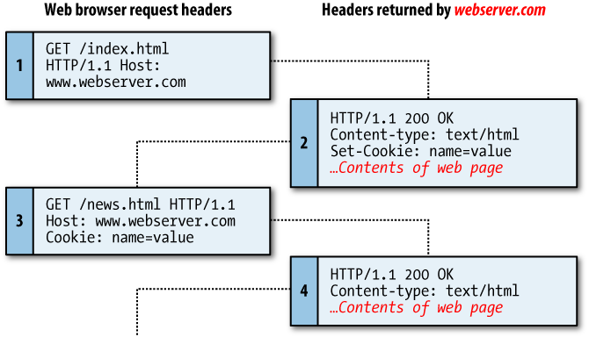

Slide 6
Setting Cookies
As long as no HTML has yet been transferred, you can call the setcookie function
setcookie(name, value, expire, path, domain, secure, httponly);
Example:
setcookie('username', 'Hannah', time() + 60 * 60 * 24 * 7, '/');

Slide 7
Accessing Cookies
Like $_POST, $_GET, and $_SESSION there is a $_COOKIE value included in PHP
To read it simply call the variable with the specified heading you wish to read:
if (isset($_COOKIE['username'])) $username = $_COOKIE['username'];
However, if the cookie was issued recently it takes a page reload or load to a new page before the cookie can be read

Slide 8
Destroying Cookies
Unlike creating and reading cookies the method for deleting them manually is a bit difficult
To delete a cookie the value of the cookie must be updated to expire in the past
If all the parameters of the update (with the exception of the timestamp) are the same the delete will succeed
setcookie('username', 'Hannah', time() - 2592000, '/');

Slide 9
Exercise
Using cookies, create a form that asks a user for his/her name and some comments
Create two PHP scripts that create a response:
The first script displays the information which the user has submitted and asks the user whether he/she really wants to submit the information
The second script is invoked by the first one and displays "Thank you $name. Your comments have been submitted: $comments"
Notes:
http://www.upriss.org.uk/perlcgi/p8.html

Slide 10
HTTP Authentication
For websites that require basic user management services
Allows the webserver to authenticate valid users
Useful in most instances but not the maximum user security
PHP sends a header request for authentication to the user’s browser
Web server must have feature turned on but is very common
Example 13-1

Slide 11
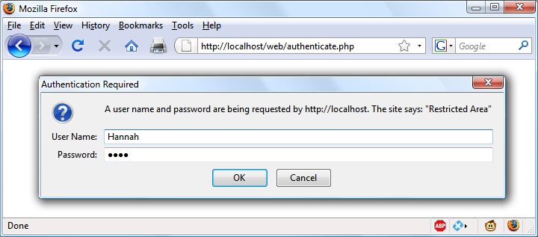

Slide 12
HTTP Authentication Issues
Once authenticated, the authentication dialog will not pop up again unless the user closes and reopens all browser windows
Error messages should be a bit vague to discourage attempts to brute force a correct login
Any log in information is stored as plaintext in the PHP files/database/web browser in the previous examples

Slide 13
Storing Passwords
One-way functions garble the submitted password so that it remains secure even if a server is hacked
Md5 hashes of text are some of the most common, but sha1 are more secure
Example:
$token = md5('mypassword');
34819d7beeabb9260a5c854bc85b3e44

Slide 14
Salting
Salting is a method of wrapping secure plaintext in a unique string to make it much harder to break
$token = md5('hqb%$tmypasswordcg*l');
So long as these are added correctly by the server when a user re-enters a password the resulting md5 should match the one stored
Example 13-4

Slide 15
Sessions
Many times it is useful to have saved information about what a user has accessed in other pages
Sessions are groups of variables that are stored on the server but relate only to the current user
A cookie is saved in their web browsers to uniquely identify each user, providing security
A get snippet is included instead if the browser has cookies turned off

Slide 16
Starting Sessions
Starting a session requires calling the PHP function session_start before any HTML has been output
To begin saving session variables, assign them as part of the $_SESSION array:
$_SESSION['variable'] = $value;
They can then be read back:
$variable = $_SESSION['variable'];
Unlike other methods sessions are stored on the server and are very secure

Slide 17
Ending A Session
When a user requests to log out, you can use session_destroy() in association with the unsetfunction,
a useful function for totally destroying a session, logging a user out, and unsetting all session variables
A timeout may be set in case a user does not remember to manually logout or close the browser
ini_set('session.gc_maxlifetime', 60 * 60 * 24);

Slide 18
Session Security
Using https or SSL based security reduced the likelihood of malicious users misusing stored session information
Locking sessions to IP addresses as well as usernames also helps
$_SESSION['ip'] = $_SERVER['REMOTE_ADDR'];
It is often useful to store the HTTP User agent as well in order to access certain browser information
$_SESSION['ua'] = $_SERVER['HTTP_USER_AGENT'];

Slide 19
Session Security
Using session_regenerate_id() will force any open sessions to new ids making it so malicious users can’t hijack others
You can also force users into using cookies (although this limits your potential users)
Any data generated by your site should be stored in a folder that is not shared with other users and is not accessible from the web
It should also be periodically cleared

