Slide 1
Object Oriented Design
COSC 315
Fall 2014
Bridget M. Blodgett

Slide 2
Why OOD?

Slide 3
Efficient Code
Right now every time we want to draw a sprite on the screen we duplicate the code we’ve written
This is inefficient both in terms of lines of code written and good use of programmer time
Some Object Oriented design will help reduce this inefficiency

Slide 4
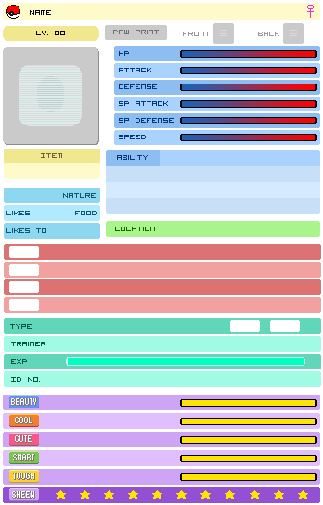

Slide 5
Classes
A class is like a blueprint for pieces of code that work in similar ways within your game
Right now the rings and skull act differently but the basics of how they operate are pretty much the same
This will be true for most of your sprites
So a sprite class would be useful to add to your program to make creating sprites easier

Slide 6
Class Components
Although these aren’t required for a class most classes have at least one of the following (and usually more than one)
Property/Member – these are class specific variables
Methods – these are class specific functions

Slide 7
UML
An attempt to create a way to make programming “blueprints” for design
It takes common program interactions and considerations and maps them to charts
Allows you to communicate and plan the design of your program

Slide 8
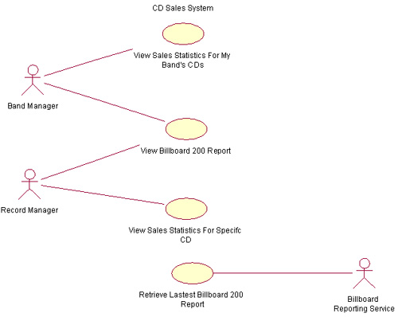
Use-Case Diagram
Notes:
All diagrams from: http://www.ibm.com/developerworks/rational/library/769.html

Slide 9
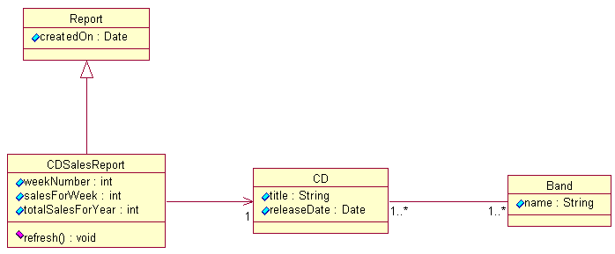
Class Diagram
Notes:
All diagrams from: http://www.ibm.com/developerworks/rational/library/769.html

Slide 10
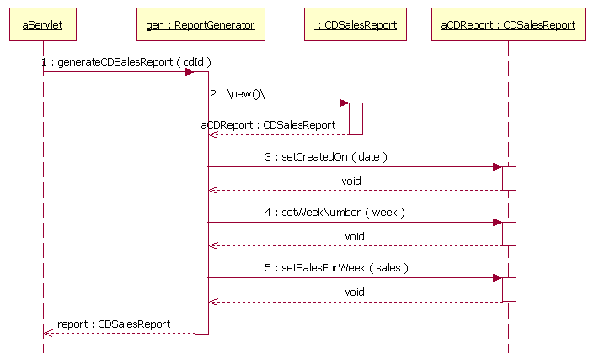
Sequence Diagram
Notes:
All diagrams from: http://www.ibm.com/developerworks/rational/library/769.html

Slide 11
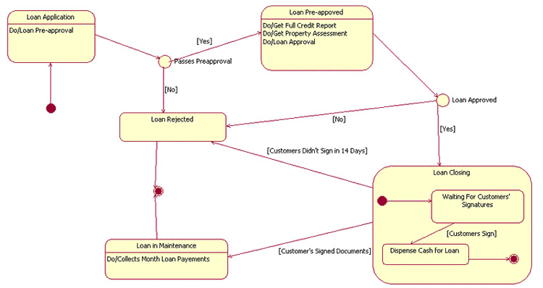
Statechart Diagram
Notes:
All diagrams from: http://www.ibm.com/developerworks/rational/library/769.html

Slide 12
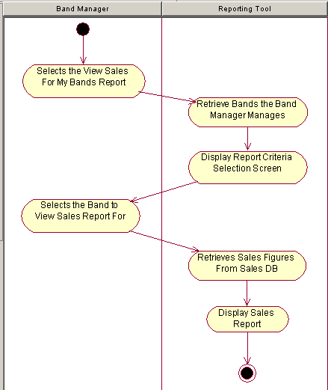
Activity Diagram
Notes:
All diagrams from: http://www.ibm.com/developerworks/rational/library/769.html

Slide 13
Abstract Classes
We will make our sprite class abstract
This means that XNA will not allow you to make instances of that sprite
It a way of setting up some basic controls but then only allowing the more detailed classes that are children of the abstract to be instantiated

Slide 14
Adding a Class
Right click the solution explorer and add a class named Sprite.cs
Add the abstract keyword to the front of the class definition
Enable use of XNA with using Microsoft.Xna.Framework; using Microsoft.Xna.Framework.Graphics;
Add the variables on the next slide

Slide 15
Texture2D textureImage;
protected Point frameSize;
Point currentFrame;
Point sheetSize;
int collisionOffset;
int timeSinceLastFrame = 0;
int millisecondsPerFrame = 16;
protected Vector2 speed;
protected Vector2 position;

Slide 16
public Sprite(Texture2D textureImage, Vector2 position, Point frameSize, int collisionOffest, Point currentFrame, Point sheetSize, Vector2 speed) : this (textureImage, position, frameSize, collisionOffset, currentFrame, sheetSize, speed, defaultMillisecondsPerFrame)
{
}
public Sprite(Texture2D textureImage, Vector2 position, Point frameSize, int collisionOffest, Point currentFrame, Point sheetSize, Vector2 speed, int millisecondsPerFrame)
{
this.textureImage = textureImage;
this.position = position;
this.collisionOffset = collisionOffset;
this.currentFrame = currentFrame;
this.sheetSize = sheetSize;
this.speed = speed;
this.millisecondsPerFrame = millisecondsPerFrame;
}

Slide 17
What to Add?
When creating methods for your class you want to think about the bare shared actions all objects of that class will need to take
Things that are above the base shared actions can probably be defined in other classes
For the sprite all we need to do is update and draw the images from the spritesheet to the screen

Slide 18
public virtual void Update(GameTime gameTime, Rectangle clientBounds)
{
timeSinceLastFrame += gameTime.ElapsedGameTime.Milliseconds;
if(timeSinceLastFrame > millisecondsPerFrame){
timeSinceLastFrame = 0;
++currentFrame.X;
if(currentFrame.X >= sheetSize.X)
{
currentFrame.X = 0;
++currentFrame.Y;
if(currentFrame.Y >= sheetSize.Y)
{
currentFrame.Y = 0;
}
}
}

Slide 19
public virtual void Draw(GameTime gameTime, SpriteBatch spriteBatch)
{
spriteBatch.Draw(textureImage, position, new Rectangle(currentFrame.X * frameSize.X, currentFrame.Y * frameSize.Y, frameSize.X, frameSize.Y), Color.White, 0, Vector2.Zero, 1f, SpriteEffects.None, 0);
}

Slide 20
New Things
the virtual keyword used in both class definitions means that we can make changes to this method in children classes
The sprite class requires a few things we didn’t have previously
A property called direction
A property for collision detection

Slide 21
public abstract Vector2 direction
{
get;
}
public Rectangle collisionRect
{
get
{
return new Rectangle((int) position.X + collisionOffset, (int)position.Y + collisionOffset, frameSize.X – (collisionOffset * 2), frameSize.Y – (collisionOffset * 2));
}
}

