Slide 1
3D Cameras
COSC 315
Fall 2014
Bridget M. Blodgett

Slide 2
3D Challenges
With 2D we only needed to think about objects in a flat space
3D adds the z-axis which makes things slightly more complicated
It also allows us to use items like cameras to create depth and increase challenge
The player can no longer see the entire screen

Slide 3
3D Camera
You will need to create a camera class that you can then make instances of within your game
Cameras have two important matricies called view and projection that contain all the information needed to properly set up and work a camera
In a new game component class called Camera add two variables
public Matrix view {get; protected set;}
public Matrix projection {get; protected set;}

Slide 4
Camera Constructor
After the variables you will need to make a constructor for the camera class
public Camera (Game game, Vector3 pos, Vector3 target, Vector3 up): base(game){
view = Matrix. CreateLookAt(pos,target, up);
projection = Matrix.CreatePerspectiveFieldOfView(MathHelper.PiOver4, (float)Game.Window.ClientBounds.Width / (float)Game.Window.ClientBounds.Height, 1, 100);
}

Slide 5
Making a Camera
Now that the camera class is set up we can create an instance of the camera in our Game1 class
You will need a class level variable called camera and to call the Camera constructor in initialize()
camera = new Camera(this, new Vector3(0,0,5), Vector.Zero, Vector3.Up);
Components.Add(camera);
With this you have a working camera (but nothing to look at)

Slide 6
Primitives
Most game suites include some ability to handle primitives
These are simple shapes you can draw to the screen and combine to make game objects
Drawing a triangle is easiest (and is the base of most graphics creation)
By combining triangles you can create every other shape, including mimicking smooth curves

Slide 7
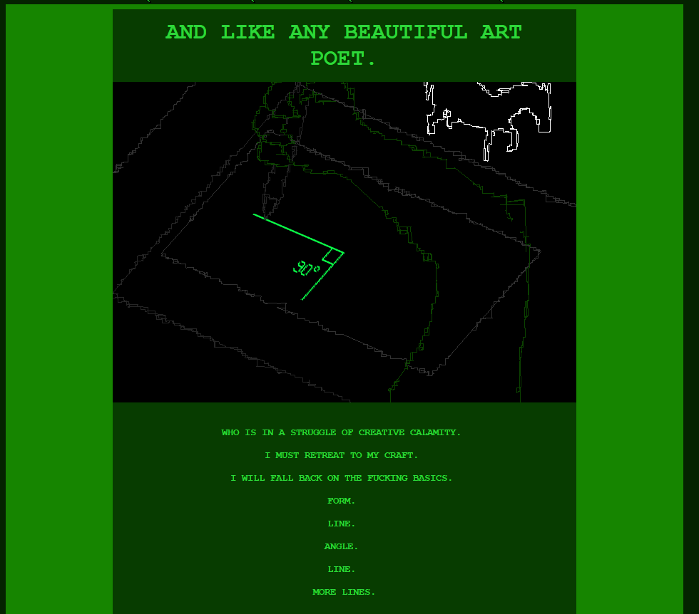
Notes:
From http://www.mspaintadventures.com/

Slide 8
Creating Triangles
The way primitives are handled is in two steps:
The shape is stored as points on a 3D plane and their connecting lines
Once the full shape has been stored then the program follows the saved information to draw the lines on the screen
Without both steps you won’t successfully be able to draw the object

Slide 9
Create a game1 class variables:
VertexPositionColor[] verts;
VertexBuffer vertexBuffer;
BasicEffect effect;
In LoadContent()
Verts = new VertextPositionColor[3];
Verts[0] = new VertexPositionColor (new Vector3 (0,1,0)

