Slide 1
Marketing
COSC 405
Spring 2013
Bridget M. Blodgett

Slide 2
Meaning
Marketing is a term that is thrown around a lot
What are some common uses of the term marketing?
How do they differ from other similar terms like public relations(PR)?

Slide 3
Importance
This program focuses a lot on the development of actual games:
Having a strong portfolio can get you a job
But developing a game and then trying to sell it (indie style) isn’t actually a good strategy
Why?
The starting point of all marketing should be to define your goals

Slide 4
Goals
Who is the customer?
What does the customer desire from the product?
Where will the customer purchase the product?
Why does the customer buy the product?
When does the customer purchase the product?
How does the customer seek satisfaction in the market?

Slide 5
Four Ps
Conceptually marketing is focused around four topics (the 4Ps)
Product
Price
Place
Promotion
These Ps are good general background and guidance
They don’t represent something that works in detail (Marx’s Manifesto vs. Russian Communism)

Slide 6
Product
This is the part most often focused upon by game companies
It’s what is actually being sold
It’s not always what is being marketed
Two key words: want and need
Have to make sure you’re actually proving both!
Designing Demos
Are they even needed?
Demos can sell products OR break them

Slide 7
Modern Demos
One type of demo is still really relevant…
Episodic games
These can often keep people playing and invested in the game well after its normal shelf life has expired
How many of you would pick up Half Life 2: Episode 3 if it came out tomorrow?
This can be very lucrative way to both attract and audience and keep them hanging around
Spartan Ops is another example

Slide 8
Package: The Hidden Product
This needs to be attractive, thematic, and just informative enough to pull people in
Those six bullet points (Unique Selling Points ) in the back matter!
Both for sales of the game AND for marketing it to publishers
Packaging plays into and may be the first intro to the gestalt of the game
How does this work with digital distro?

Slide 9
Price
Price is not the same as value
The value of the product should always be greater than its price
Methods of pricing:
Prestige Pricing (collector’s edition)
Penetration Pricing (Minecraft)
The Hardest Dollar (Steam Sales)
Intangible Terms of Sale (Crackdown’s Halo Demo)

Slide 10
Place
Where do people buy and/or try your game?
Retail (Physical Stores)
Requires a publisher and the largest up front cash investment ($100,000 - $200,000+) and may not net you much in return
Mailed CDs/DVDs
This can be through a digital storefront (Bestbuy.com) or offered alongside another method (CustomCD)
Digital Download
Have to cover multiple places for access
Online Publishers

Slide 11
Promotion
What most people think about when they say marketing
Combination of advertising, publicity, and buzz
Buzz is the most famous but the hardest to control and the one you want to focus on the least
Publicity is free advertising (talk shows and interviews before movie premieres)
Requires tenacity, a plan, and a fearlessness about being annoying

Slide 12
Advertising
Easiest of the three types of promotion
Also the most expensive
Must know your target market and conversion rate
What is conversion rate?
What is a target?
Know where are useful places to purchase advertising in terms of ROI

Slide 13
Marketers
The most important thing to marketers (researchers/strategists) is identifying what customers (real or potential) want
This may actually exclude the bulk of the population
Then they try to find ways to meet those desires

Slide 14
Targeting
Bulls-eye targeting
Go after those most likely to purchase – usually pre-existing users
Competitor targeting
People interested in similar games, advertise on your competitor’s name, volume offsets percentage
Horizontal targeting
Knowing when to use it is important, often cheaper than a vertical move with a higher focus
Vertical targeting
The most common go-to, high competition, high price, low return

Slide 15
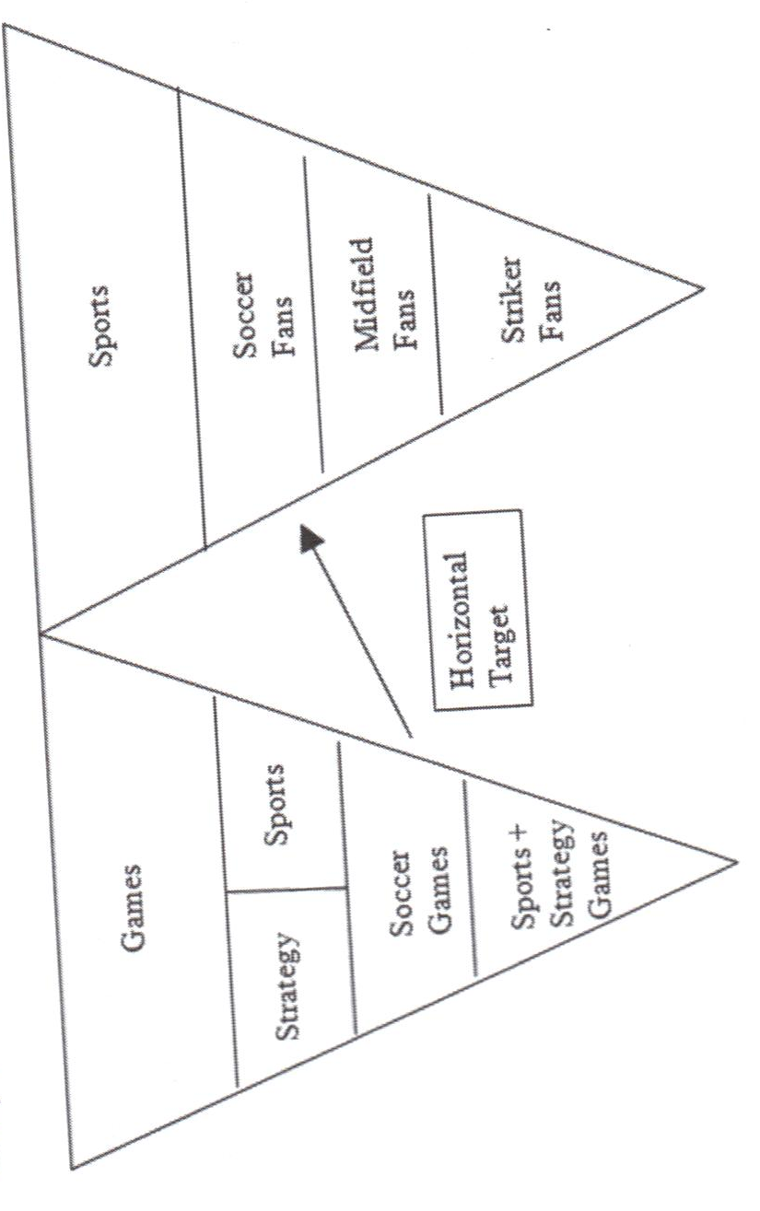

Slide 16
Common Questions
How does X profit from spending Y on ads?
Sometimes ads don’t always have a positive ROI (lost leader strat)
Not a great choice for small developers/indie dev
What about print/radio/tv?
High cost, low return, better for brand awareness (Why is this good for WoW or Halo?)
What is the most effective form of online ads?
Potentially email, but generally depends

Slide 17
Ad Lingo
CTR
CPM
CPC
CPA
ROI
RPM
IAB
RON/ROS

Slide 18
Marketing Games vs Companies
While there is a link between your game and your company they aren’t the same thing
First priority is selling the product
Without cash in hand a good company rep is worthless
Once your further into the marketing campaign then consider introducing the company
Knowledge of the game creates a positive mental link and deepens interest in your product(s)

Slide 19
Four Phases of Marketing
Pre-development
Market studies to see what is currently available, what it needs, what it doesn’t want
Pre-Release (Post-development)
Everything that needs to be set up for launch day
Release
Maintaining during launch, PR to spread launch
Post-Release
Support promotion, measuring results, adjustments

Slide 20
Pre-Release
Perfect your game
Working game, beta tested and improved
Set up the website
Lots of information about the game
SEO to increased accessibility
Public relations
Press kit, Demo(?), Previews, Trade Shows
Price

Slide 21
Release
Sell, sell, sell
At launch the game should be accessible and ready to play/support players (MMO fails)
Measure Sales
Start gathering data including demographics, adjust pricing, gather feedback for improvements
Overclock PR
Buy advertisements, distribute new presskits, journalists and media

Slide 22
Post Release
Don’t stop promoting
Update the marketing strat based upon feedback and demographics you’ve gathered
Measure sales
Make sure you’re getting the return and percentages you were aiming for, look for surprises or inconsistencies in sales data, evaluate your advertising
Game adjustments
Get customer feedback and rebalance as necessary
Explore options
Begin looking at sequels, other publishing outlets, other money generating tie-ins

Slide 23
Knowing Your Audience
Do your research
Often many free sites offer general demographics info or you can pay a company to get specific info (or try to gather it yourself) or you can buy the data from someone else
Not just for kids
Keep up with demographics changes
Not just 18 – 35 y.o. males
Market segmentation
Take your total market and break it down (geographic, demographic, psychographic, or behavioral)
User types
Notes:
US Census http://www.census.gov
http://www.freedemographics.com
ESA http://www.theesa.com
http://www.medialiteracy.com
Pew Internet http://pewinternet.org/Data-Tools/Get-The-Latest-Statistics.aspx

Slide 24
Live Advertising
Trade shows are often big marketing events
Used to announce large changes (new console gen) or big game launches (ESO)
Trade shows are often expensive and have high expectations in terms of presentation
Can generate word of mouth quickly
Beginning to decline in importance overall

Slide 25
Mistakes to Avoid
Lack of a vision
Inadequate research
Design duds
Thinking too small
Not knowing when to stop

