Slide 1
Team Building
COSC 405
Spring 2013
Bridget M. Blodgett

Slide 2
Establishing a Team
Honestly answer these questions about yourself first:
Who are you?
What do you like doing?
What is your goal?

Slide 3
Team Structure and Composition
Although team structures can vary from company to company or project to project there are some similar roles that they tend towards
Student Teams
Indie Teams
Professional Teams
What tends to be the important factors shaping these general roles?

Slide 4
Student Teams
This is the type with which you are most familiar
Usually have specific goals and requirements they must address
Teams are comprised of all students which allows for similar schedules, equal experience and skill, high driving force/passion
Focuses on a “many hat” approach

Slide 5
Indie Teams
Handful to a few dozen members seeking to make games for profit
Members usually have some prior experience in game dev
Occasionally made up of students but can include senior/pro devs that are contractually allowed to
Scope of the game is bigger, roles are more defined, sometimes not co-located
Big questions involve how to reward/incentivize developers on the team (royalities, percentages, etc)

Slide 6
Professional Teams
Several dozen in-house employee groups composed of very experienced developers
The structure and roles are very strict with little or no overlaps
Cross-collaboration occurs in small mixed group meetings
Benefits are often more formalized and similar to regular IT businesses in addition to financial compensation

Slide 7
Building Your Team
Hire who you need not who you know
Although friends and family can have useful skills they may not always be the best fit
Make sure your offers will improve the quality of the product and help you to exceed your minimum standards
Diversity is the spice of life
Games are a creative enterprise and require many different viewpoints and ways of thinking as well as skills

Slide 8
Building Your Team
Hire people for the job they’re meant to do
Never hire for secondary skills, they’re going to fill a particular role then they should be good at it
If their skills are too good to pass up consider a part time contract or create a new position for them
It’s not who they know its who knows them
It’s easy to appear to have connections but the good connections should be reciprocal

Slide 9
Building Your Team
Always remember that you have to work with them
If the person has not meshed well with the other employees or shows undesirable traits don’t hire them
All game development is done in a team and one bad team player can fail the project

Slide 10
Common Team Roles
Upper management:
Studio head
Producer
Creative director
Art director
Director of engineering
Lead designer
Holy Trinity
Engineers
Artists
Designers
Everyone Else
QA Testers
IT Support
Operations
Marketing/PR
HR

Slide 11
Employee Paperwork
NDA
Non-Compete
Assignment of Inventions
Tax and Eligibility forms
Application
Background Check

Slide 12
Managing Your Team
Everyone gets a voice
Not everyone makes decisions
Collaboration is a valuable tool
Be a team outside of work
Recognize and handle conflicts immediately
Managers need to be able to handle the day-to-day (i.e. first mate to your captain)

Slide 13
The Ideal Manager
Managers must keep team: on schedule, motivated, and happy
Or fix the problem if any of these three fail
8oz interpersonal skills
16oz patience
8oz time management skills
3c relevant department knowledge
Dash of humor
Blend until smooth and server warm

Slide 14
Organizational Management
Flatter organizational charts improve communication and production
You need “core” working hours that allow for some personal flexibility
This also requires up-to-date contact information for everyone

Slide 16
Management/Production Methods
Two of the most common methods you will encounter are the traditional or “waterfall” method and agile management/production
You should be familiar with the waterfall method since it’s the one most often used in the classroom setting
It is also the original method that the IT and software industries followed since it is based on traditional manufacturing

Slide 17
Waterfall Method
The basics of the waterfall method is that the design and development process can be seen as a sequence of steps
You need to reach 100% completion on each step before moving to the next
The main idea is: Big Design Up Front which puts most of the customization and design time early in the process
Changes later in the process occur at both higher costs and losses
The model also places a heavy emphasis upon documentation

Slide 18
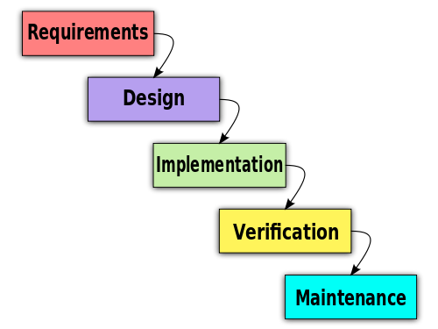
Notes:
http://en.wikipedia.org/wiki/Waterfall_model

Slide 19
Agile Development
There are two different types of Agile Development that you may encounter:
Agile software development
Agile Management
The goal of both is to use iterative methods in a flexible and interactive manner to produce (typically) an IT product
It is often best used as one part of a wider development, small-scale projects, or complex projects that involve user feedback before prototyping
Notes:
For more information: http://www.agileleadershipnetwork.org/

Slide 20
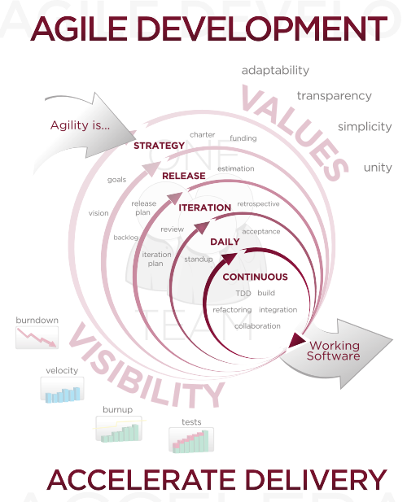
Notes:
Agile Development – a systems development strategy wherein the system developers are given the flexibility to select from a variety of appropriate toools and techniques to best accomplish the tasks at hand. Agile development is believed ti strike and optimal balance between productivity and quality for systems development
http://en.wikipedia.org/wiki/Agile_software_development

Slide 21
Iterative Life Cycle
In an iterative life cycle more than one stage of the development or planning process may be occurring at the same time
The goal is to develop your product through many cycles of the design process (iterative) in smaller portions (incremental)
The idea is to take advantage of prior learning
There is less of a focus on documentation
It can occasionally be difficult to decide when to begin an new iteration or when to push forward

Slide 22
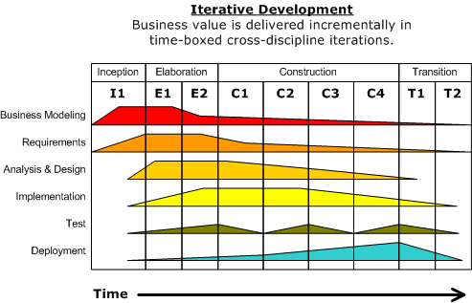
Notes:
http://en.wikipedia.org/wiki/Iterative_and_incremental_development

Slide 23
Pair Programming
One method of software development that is frequently used alongside agile management
Two programmers use one workstation to program
One “drives” by actually writing the code while the other “observes” the code as it is written, periodically they switch roles
The goal of paired programming is to prevent errors, allow freedom to code, provide foresight and planning
Useful for integrating and bringing up to speed new team members

Slide 24
Spooning?
https://bitbucket.org/spooning/

